Slide 1
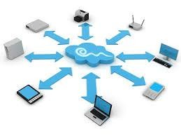




Collaboration | Innovation | Excellence
Collaboration | Innovation | Excellence
Testing Capability Deck
ICONMA confidential

Slide 2


Agenda
Company Overview
Highlights
Testing Practices
Quality Assurance and Test Automation Services
Testing Expertise
Manual Vs Automation
Automation Testing Paradigm’s
Performance Engineering
Mobile Testing
Additional Testing Services
Case Studies
Partners

Slide 3
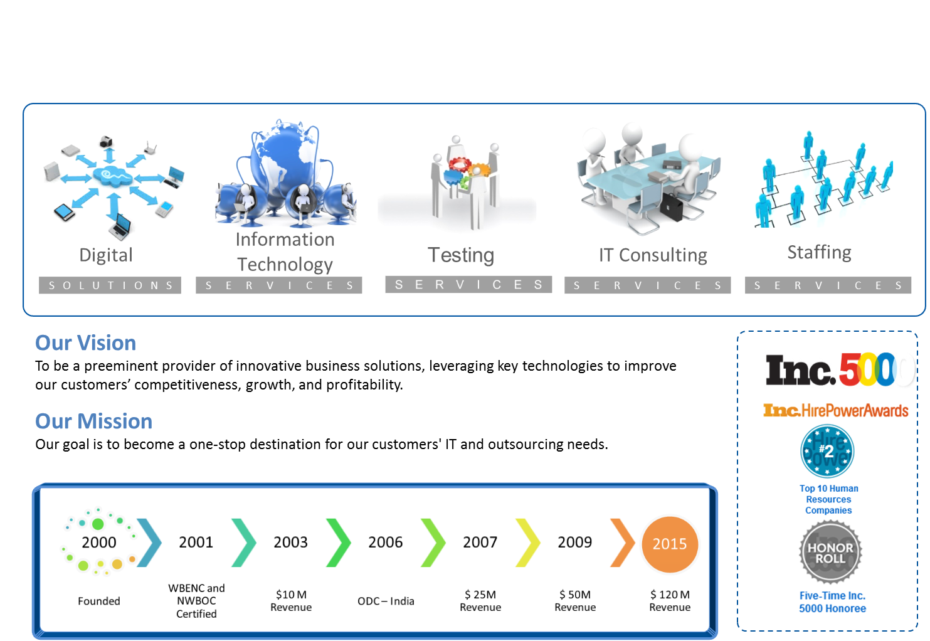
Company Overview

Slide 4
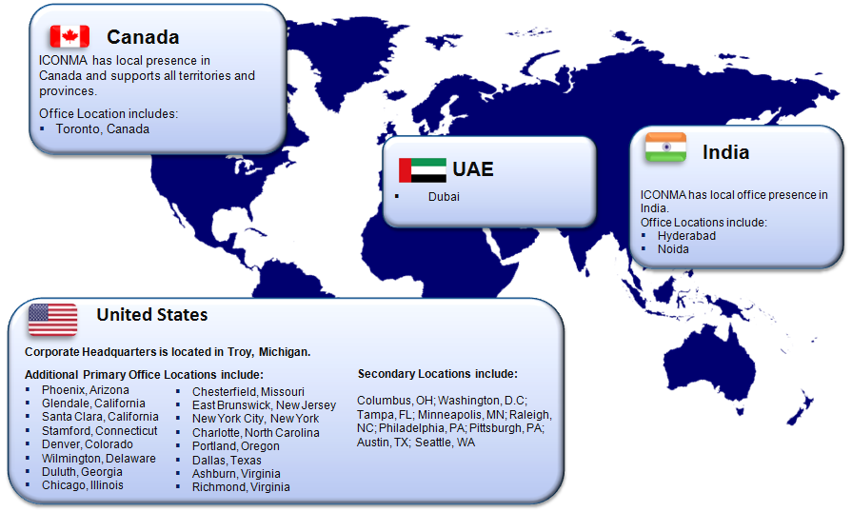
Quick Snapshot : Locations

Slide 5
Highlights
Has about Overall 500+ Test Engineers deployed across engagements
Responsible for managing Entire Testing Activities for Global Customers from start to finish (End to End) which includes
    Resource Ramp up and Ramp down
    Licensed Tools Maintenance such as UFT
    Complete maintenance of Test Labs for ease of Execution
    Adapting to latest technology trends from time to time
    One Point of contact for all the Testing needs
    Adapting to different various models.
    JIRA Tool for Agility model
    Expertise in BDD

Slide 6
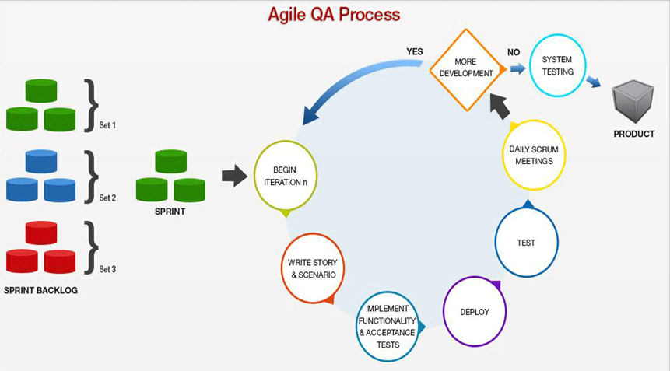
Testing Practices -Agile

Slide 7
Agile Process
In the world of software development, the term agile typically refers to any approach to project management that strives to unite teams around the principles of collaboration, flexibility, simplicity, transparency, and responsiveness to feedback throughout the entire process of developing a new program or product.
Agile testing generally means the practice of testing software for bugs or performance issues within the context of an agile workflow.
Each Sprint is set to Two or Three Weeks
User Stories would be picked from Sprint Backlog and the Testing would be in progress at every Sprint having Daily Scrum Calls
Sprint Retrospective Meetings would be held after the completion of each Sprint
Project Demo is showcased to the Client/Customer to have the feel of the Application Developed

Slide 8
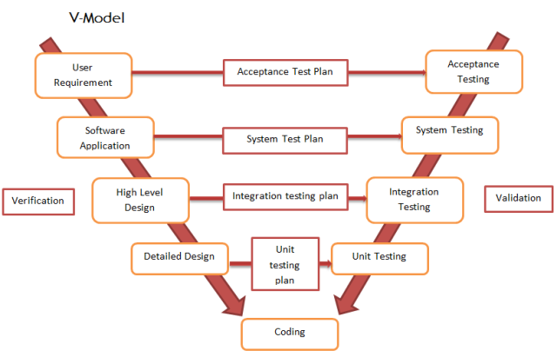
Testing Practices –V Model

Slide 9
Best Testing Practices –V Model
It is an Extension of waterfall model.
Needs to plan Testing Activities in Parallel.
It helps in identifying Planning and Design of Testing in early stages of Development Process.
Left Arm of ‘V’ model is conventional Waterfall Model.
Right arm of ‘V’ Model- It corresponds to testing methodology required at each phase of development.
Development and Testing both get equal importance and it forces management for their commitment, attention and planning of required resources.
Output from the developer phases can be tested or reviewed by testing team.
Major purpose of V Model is to meet business requirement and provide confidence before it is delivered.

Slide 10
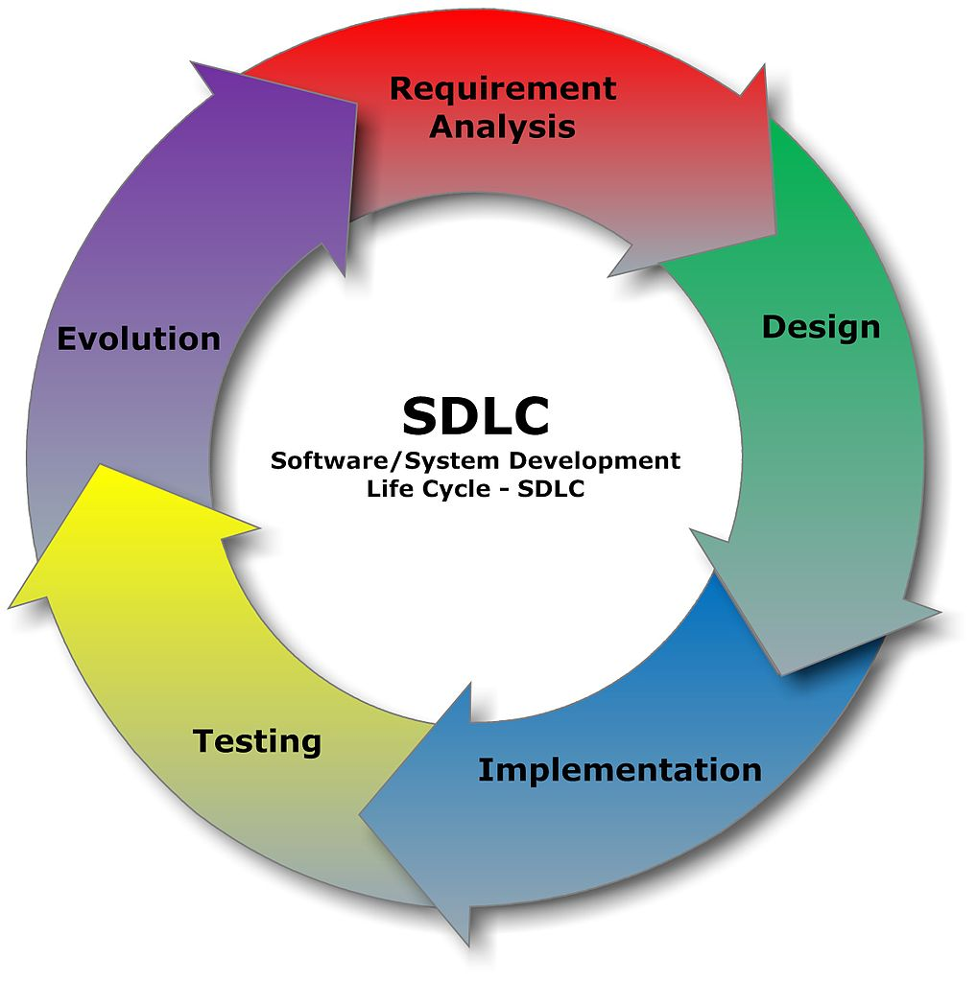
Testing Practice – Waterfall Model

Slide 11

















Quality Assurance and Test Automation Services
QA Advisory Services
Testing as a Service
QA Automation
QA Project Sourcing
Optimization assessment and roadmap definition for QA Methodology
Define testing strategy
and execution model
Setting up processes to define metrics and measure QA effectiveness
Full spectrum of QA and testing services delivered through Onsite /offshore model for –
Functional and performance test automation across varied tool stacks
ICONMA Proprietary methodology to accelerate test automation building and execution
Integration with test management tools and custom reports
Staff and manage QA teams to deliver against defined scope
Ensuring cost arbitrage by creating smaller dedicated teams with flexibility to scale team size on demand
QA planning and test design
Test case development
Functional testing
Integration testing
Regression testing
Performance testing
Technical Capability
Open Source (Selenium)
HP (Loadrunner, QTP, QC)
Microsoft (CODED UI TEST)
IBM (RATIONAL)
Borland (SILK TEST)
Parasoft(SOATEST, C++TEST)
Jmeter
SoapUI
HttpWatch for Client Performance Testing
Behavior Driven Design

Slide 12










Testing Expertise
Enterprise Mobile Solutions
Static & Dynamic Enterprise Portals with eCommerce
LMS and KMS
Digital solutions for:
  Healthcare industry
  Automobile Industry
  Media & Entertainment
  Hospitality Services
  Retail
Team of Certified Testers
Team with Domain specializations
Team with Technical Testing capabilities
Center of excellence Teams for Automation and Performance
Dedicated Frameworks for Regression Testing packs using open source tools
Specialized in Performance Testing using VSTS,Load Runner and Open source tools
      Solutions
Domains
Specializations
Java
.NET
Share Point
Mobile Technologies
Selenium Web driver
QTP/UFT
Load Runner
Jmeter
VSTS
RFT
Appium
SOAPUI
Security Testing
    Technologies
Technologies
Tools

Slide 13




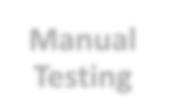
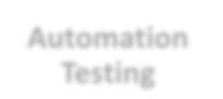
Manual vs Automation
Manual
Automation
Testing
Testing
1. Time consuming and tedious: Since test cases are executed by human resources so it is very slow and tedious.
1. Fast: Automation runs test cases
significantly faster than human resources.
2. Huge investment in human resources: As test cases need to be executed manually so more testers are required in manual testing.
2. Less investment in human resources: Test cases are executed by using automation tool so less tester are required in automation testing.
3. Less reliable: Manual testing is less reliable as tests may not be performed with precision each time because of human errors.
3. More reliable: Automation tests perform precisely same operation each time they are run.
4. Non-programmable: No programming can be done to write sophisticated tests which fetch hidden information.
4. Programmable: Testers can program sophisticated tests to bring out hidden information.

Slide 14



























ICONMA Auto Test Lab (Single Paradigm For Multiple Applications)
Auto Framework
Maven
Jenkins
Support(Building Help Library and Customizations)
Customizes Reports
Schedulers
SVN
Other Build integration tools(TFS e.t.c)
App1
App2
App3
App..n
Features
•Single Framework for Multiple Applications
•Easy To use
•Reduces manual Regression effort up to 75%
•Less Technical knowledge required as the Framework takes care of all the activities
•Multiple Data support
•Customized reports
•Schedule the regression testing without Manual intervention
•Readily available scripts

Slide 15
Page Object Model-Paradigm
PageClass1
Test Case1
Support(Building Help Library and Customizations)
Page class2
Test Case2
Page Factory
Class
TestNG.XML
Page Class n-1
Test Case n-1
Page class n
App1
Ap2
App3
App..n
Test Case n
F
Features
Writing the different Page classes
Calling Page classes from Page Factory Class
Executing tests from TesrtNG.xml
Run the Scripts from Continuous Integration Tool -Jenkins
Jenkins

Slide 16
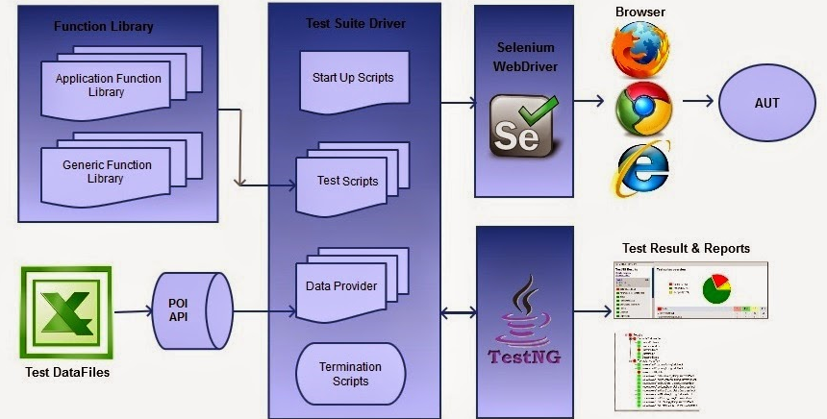
Data Driven -Paradigm
Features
Used Apache POI
Accessed data through Excel sheets
Function library was accessed to invoke application executed with Test NG
Test NG Reports/XSLT Reports were generated

Slide 17
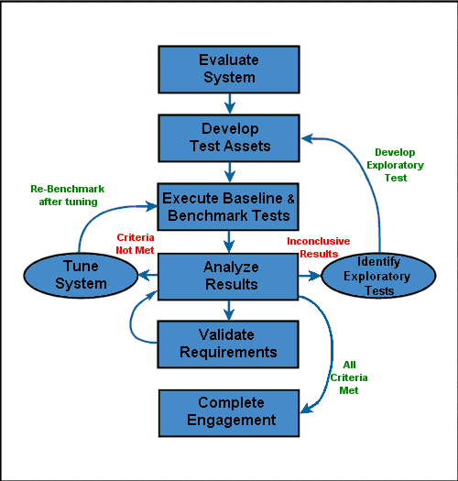



Performance Testing
Performance Testing Tools
VSTS
Load Runner
Jmeter (Open source )
NeoLoad
Webload
Rational Performance tester

Slide 18
Approach for Performance Testing
Evaluate System: Identification of , Critical Business Transactions Functionalities areas that are resource intensive
Develop Test Assets: Data preparation or Accumulation for Testing Purpose Scripts
Execute the Baseline & Benchmark Test: Execute the Scripts with single users and Standardize the Result as standard Bench Mark
Analyze The Results:Anlayse the Results(Response Timing)
Validate the Requirements: Check the Requirements
Complete Engagement:Finalise the Test
Tune System: Give Suggestion regarding the Application coding in term of Tuning to have good responses
Identify Exploratory test: Preparing the Multiple Scripts

Slide 19








Mobile Testing – Key Areas
Native
Upgrades
Function al
Key Focus Areas
Device Proliferati on
Security
Performanc e & Usability
Mobile Web
Stability
Hybrid

Slide 20















Additional Testing Services
SOA
Testing
Security Testing
SOA Framework Supporting multiple services

Slide 21
Testing Engagements and Success Stories

Slide 22
Case Study I : SARI
About the Project
      The goal of the SARI application is to facilitate the Admin user to configure and create new Menu items in the CMS along with the Submenu items which can be displayed in the front end for the End user.
      In this Application there are 3 types users mentioned as below:
- Super Admin,
- Content Creator,
-Content Approver

Slide 23
Case Study I -SARI
The following are the actions that can be performed by each user:
The Super Admin has permission to Create, View, Update and Delete the Users.
The Content creator has only permission to Create, Edit and delete the content. In order to do this initially should login with the Content Creator credentials.
The Content Approver has only permissions to approve and delete and publish the content. In order to do this initially should login with the Content Approver credentials.
Word Press is the Back end frame work which is used to develop the Application.
By configuring the plugins which are required to implement the project requirements in word press, a person can able to upload the content in back end and then can display it on the front end.

Slide 24
Case Study I -SARI
Challenges Faced while Testing:
Make sure the whole content is bug free and meaning full through out the website.
Make sure that same font family, font size and Headings & Sub Headings should be differentiated.
Make sure that the alignments are proper through out the website.
Make sure that images are with the high quality resolution.
Make sure that all the functionalities in the website are working and all the fields are provided with required validations.
Make sure that the navigation flow through out the website correctly linked.
Make sure that all the links in the website are redirecting to exact pages and internal links should be opened in the same tab and external links should be opened in new tab.

Slide 25
Case Study I - SARI
Best Practice in the project
Model: Agile model is used as the process in the project.
Environment: SARI/EI is implemented in windows as well as in Mobile and Tabs.

Slide 26
Case Study 2: GSTN
About the Project:
  A board of directors is a body of elected or appointed members who jointly oversee the activities of a company or organization.
  Formal Board Meetings happen at the regular intervals to consider the Policy Issues and major problems.
  The board meeting is presided over by a chairperson of the organization or his or her appointee.
  The Board may constitute Committees consisting of Directors to look after certain functions and to assist the Board.
  There are three roles in this Application like:
  -Super Admin(CEO)
  -Admin(Secretary)
  -User(Board Member)

Slide 27
Case Study 2: GSTN
  Super Admin-Initially Super Admin will be provided with the login credentials and he/she has rights to create the Admin.
  Admin- Admin has right to create the Users(Board Members)
  User- Users can view all the meeting requests and can reply according to that.
  This App contains the main modules like:
  -Registration
  - Login
  -Pre-Notice
  - Notice
  - Meetings
  -Board Members
  - Committees
  - Resolution by circulation
  This is the Hybrid App which is implemented in desktop and mobile environment as well.
  Device iD’s will be generated for all the devices which are being used by the Board members in the organization.

Slide 28
Case Study 2 - GSTN
Challenges Faced while Testing:
Make sure that validations are provided for all the fields in the APP.
Make sure that the Screens are replicating same as the given design.
Make sure that the alignments are proper.
Make sure that Hierarchies of the pages are correctly done.
Make sure that the navigational flow is correctly navigating.
Make sure that the links are properly redirecting to that particular pages.
Make sure that the meeting types are being created according to the schedule kept in the settings.
Make sure that no dummy user is being created with same credentials.

Slide 29
Case Study 2 - GSTN
Best Practice in the project
Model: Agile model is used as the process in the project.
Environment: Board Meeting App an Hybrid App which is implemented in windows as well as in Mobile and Tabs.

Slide 30













Global Clients / Partners

